Slide 1





Nisq algorithm to solve non-linear pde’s
Quantum science and technology
ARUNAVA MAJUMDER, 5th Year Integrated M.Sc.

Slide 2
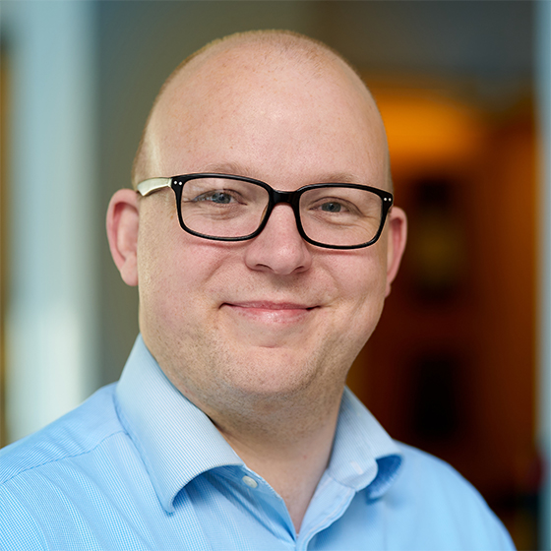

Collaborators
1/23
Peter L. McMahon
Thomas Watts
Along with other group members of PDE subgroup

Slide 3
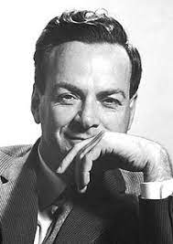
2/23
“The rule of simulation that I would like to have is that the number of computer elements required to simulate a large physical system is only to be proportional to the space-time volume of the physical system. I don’t want to have an explosion”-
Feynman, 1982

Slide 4
Variational Quantum Algorithm to solve non-linear pde’s
3/23
Steps to follow:
Exact loading of the initial condition
Time evolution of the given pde
Exact read-out
Noisy-simulation of the above steps

Slide 5
Variational Quantum Algorithm to solve non-linear pde’s
3/23
Steps to follow:
Exact loading of the initial condition
Time evolution of the given pde
Exact read-out
Noisy-simulation of the above steps

Slide 6
Overview of the talk
4/23
Nisq devices
Variational quantum technology
Non-linear pde’s
Classical & quantum Finite Difference Methods
Ansatz design & read-in

Slide 7
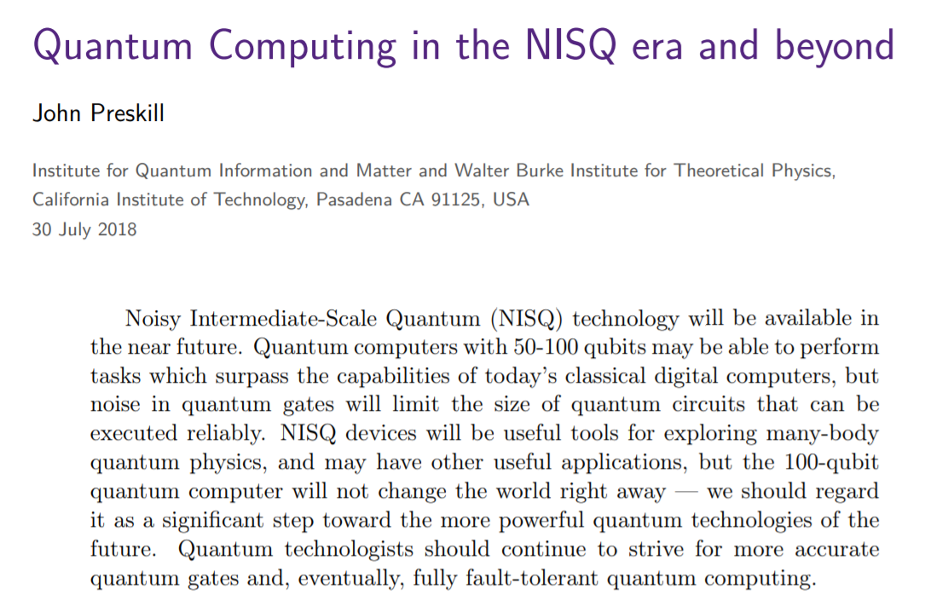
Noisy Intermediate-Scale Quantum (NISQ) technology
5/23

Slide 8
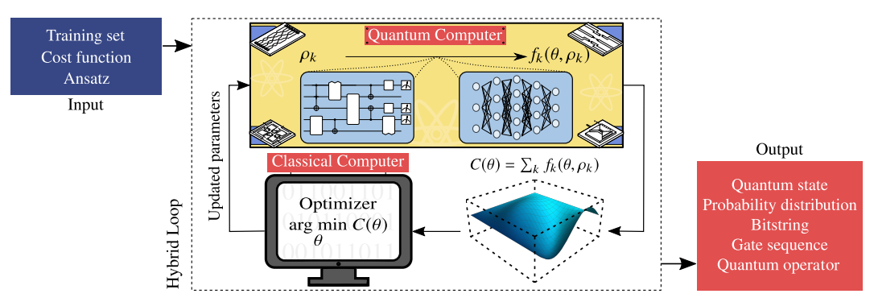
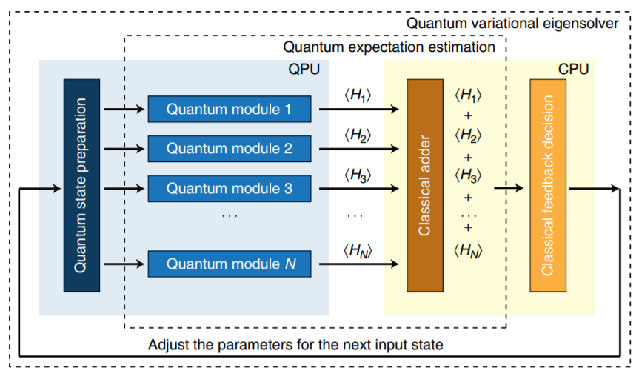
Variational Quantum technology
6/23
Overview
Overview
Applications such as simulating large quantum systems or solving large-scale linear algebra problems are immensely challenging for classical computers due to their extremely high computational cost.
https://www.nature.com/articles/ncomms5213.pdf

Slide 9
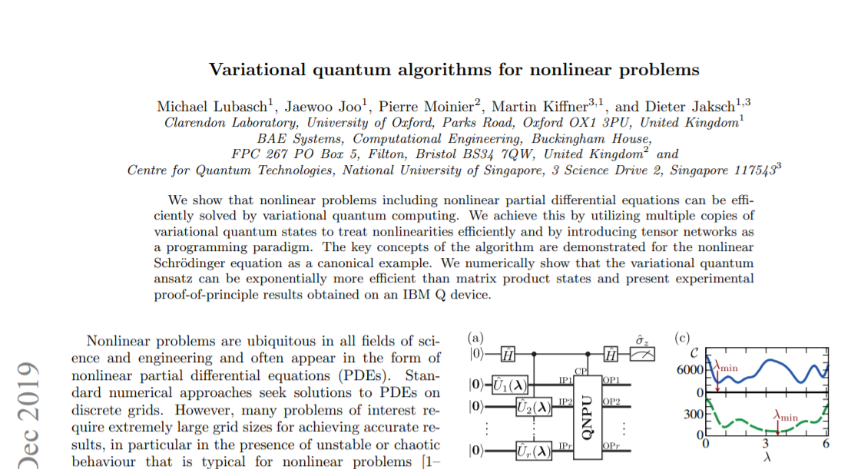
Variational Quantum Algorithm to solve pde’s
7/23

Slide 10
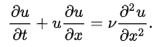
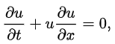
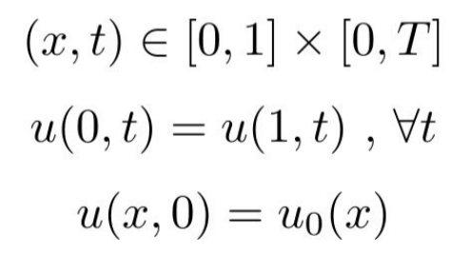
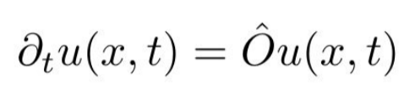
8/23
Non-linear pde’s
Consider the problem of solving non-linear wave eq.
NON-LINEARITY
Initial conditions

Slide 11
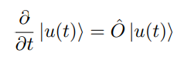
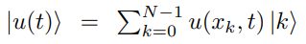
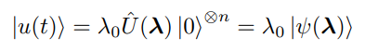
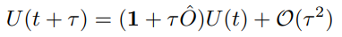
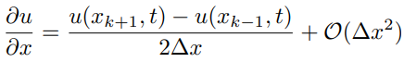
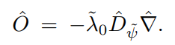
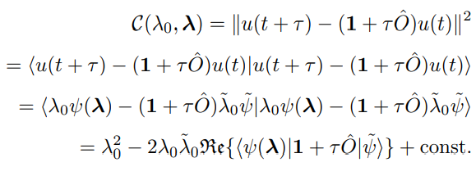
9/23
CLASSICAL FINITE DIFFERENCE METHOD
QUANTUM FINITE DIFFERENCE METHOD
Forward Euler’s method
Forward Euler cost function

Slide 12
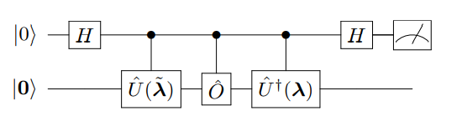
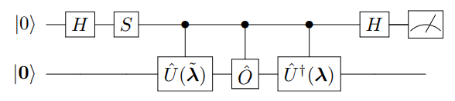
Quantum circuit for quantized cost function
10/23
To calculate REAL part of the expectation value
To calculate IMAGINARY part of the expectation value

Slide 13
Designing the ansatz to obtain exact rad-in
11/23
USING GOOGLE CIRQ SIMULATOR

Slide 14
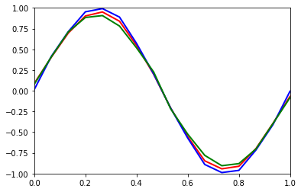
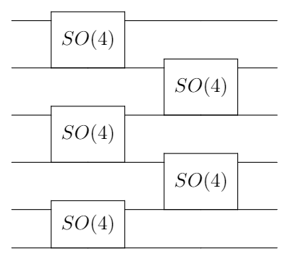
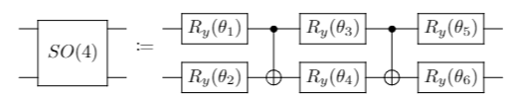
12/23
Ansatz design & read-in
Loading information about initial conditions
: Directly From circuit
/ : By solving the PDE using cost function with t=0 and the initial condition is set to be sin(x)

Slide 15
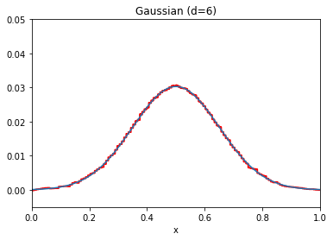
13/23
Ansatz design & read-in
Loading information about initial conditions
: From Quantum circuit
: Actual Gaussian curve

Slide 16
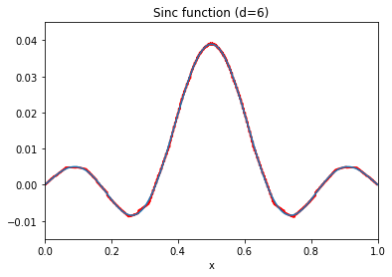
14/23
Ansatz design & read-in
Loading information about initial conditions
: From Quantum circuit
: Actual Gaussian curve

Slide 17
Scaling the problem
15/23
Restrictions:
No of gates
Total gate complexity
Hardware efficiency

Slide 18
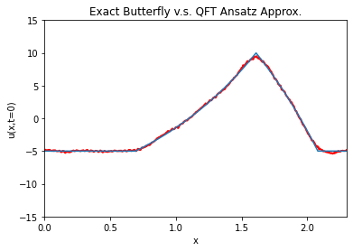
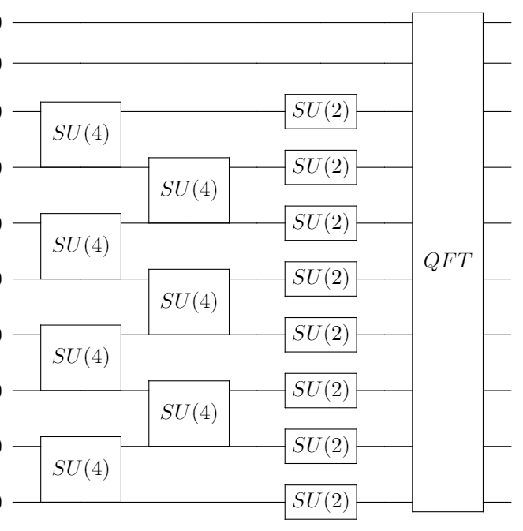
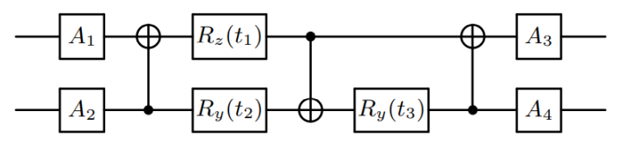
16/23
Ansatz design & read-in
Scaling the problem with 10 Qubits
Loading information about initial conditions
: From Quantum circuit
: Actual Gaussian curve

Slide 19
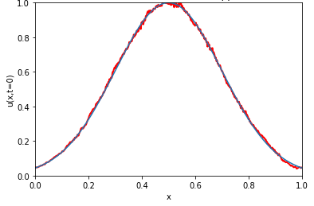
17/23
Ansatz design & read-in
Scaling the problem with 10 Qubits
Loading information about initial conditions
: From Quantum circuit
: Actual Gaussian curve

Slide 20
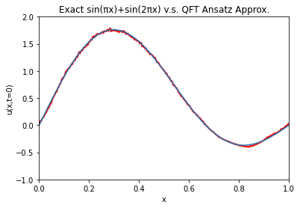
18/23
Ansatz design & read-in
Scaling the problem with 10 Qubits
Loading information about initial conditions
: From Quantum circuit
: Actual Gaussian curve

Slide 21
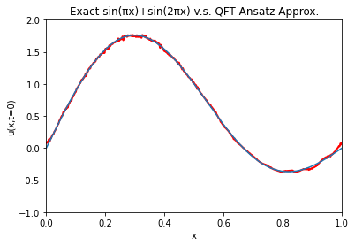
19/23
Ansatz design & read-in
Scaling the problem with 12 Qubits
Loading information about initial conditions
: From Quantum circuit
: Actual Gaussian curve

Slide 22
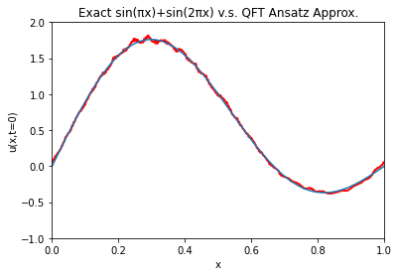
20/23
Ansatz design & read-in
Scaling the problem with 15 Qubits
Loading information about initial conditions
: From Quantum circuit
: Actual Gaussian curve

Slide 23
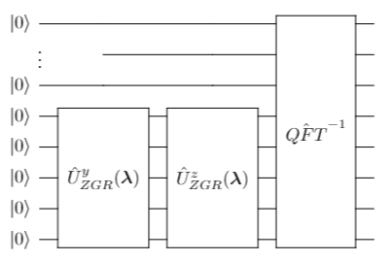
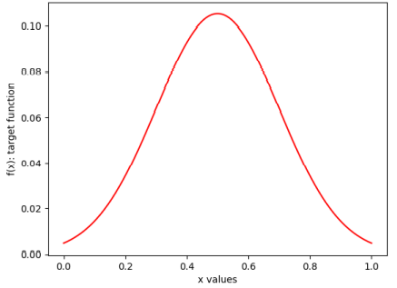
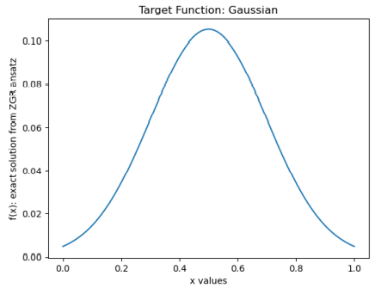
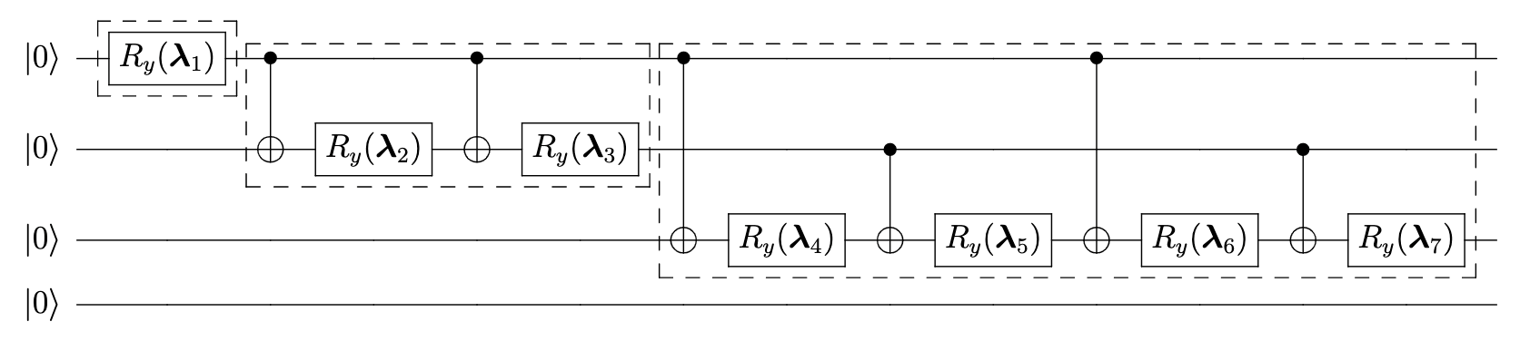
21/23
Ansatz design & read-in
Loading information about initial conditions
: From Quantum circuit
: Actual Gaussian curve

Slide 24
Thank you very much!
22/23

Slide 25
23/23

